Slide 1

Web scraping to gain company insights

Slide 2

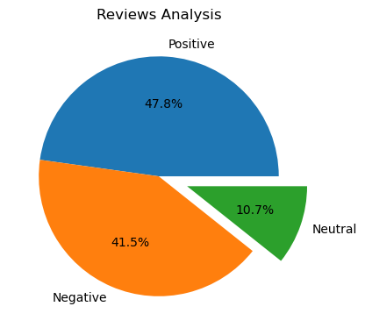
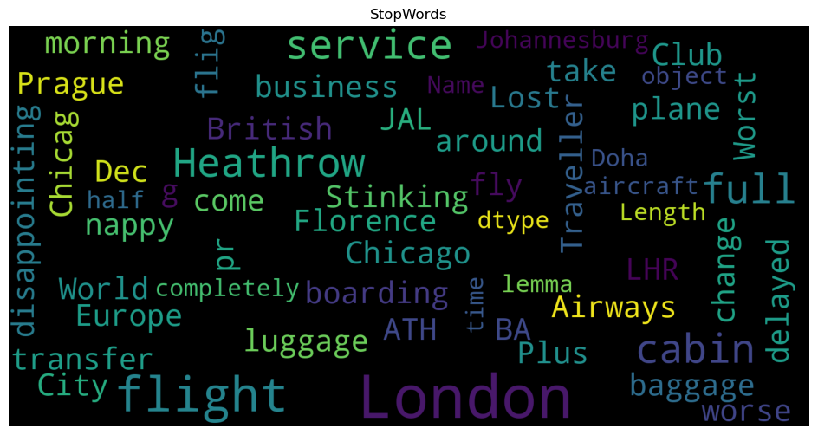
Review Distribution
Positive 478
Negative 415
Neutral 107
Numbers of Total Reviews
1000

